Slide 1
EDA
Webinar 6: Association rule & K-means clustering

Slide 2
Learning Objectives
At the end of this session you will learn about:
01
What is Association rule and Market basket analysis.
02
What is clustering.
03
K-means clustering.

Slide 3
Associations in Data
It is a process that discovers the probability of the co-occurrence of items in a collection.
The relationships between co-occurring items are expressed as association rules
Association rules are often used to analyse sales transactions.
Association Analysis helps to identify cross-selling opportunities.
Rules resulting from the analysis can be used to place associated products together in a catalogue, supermarket, or a web shop.
It can also be applied when targeting a marketing campaign for product C at customers, who have already purchased product A.

Slide 4
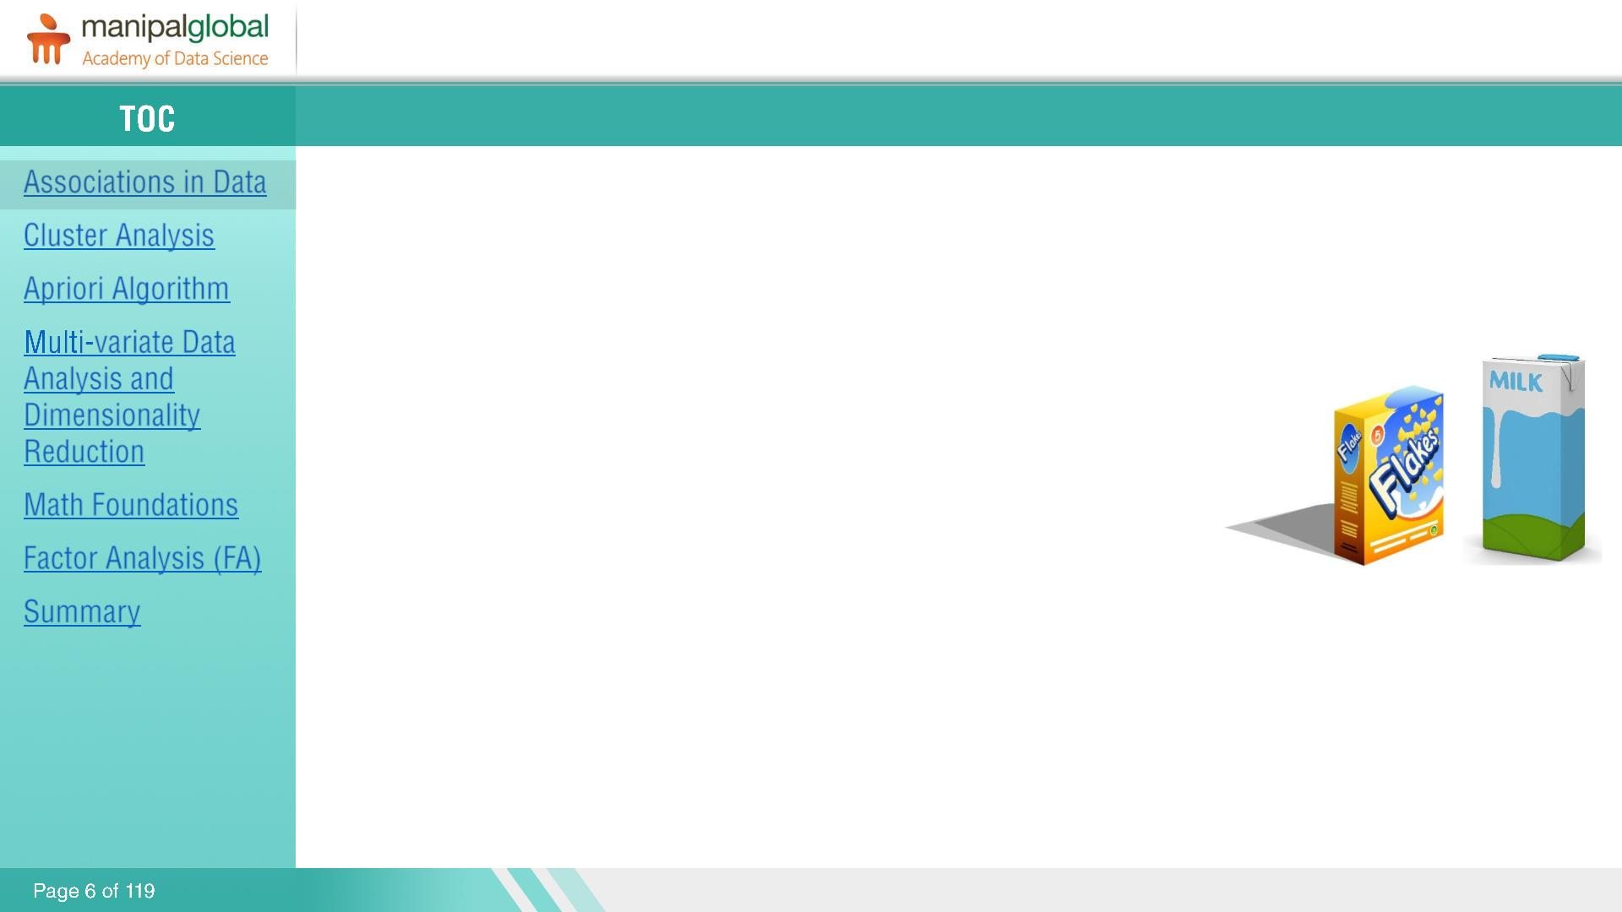
Example
Customers who buy cereal at the grocery store often buy milk at the same time.
Association analysis might find that 85% of the checkout sessions that include cereal also include milk.
This relationship could be formulated as ‘Cereal implies milk with 85% confidence.’
This application of association modeling is called Market-basket Analysis.
The purpose of association analysis is to find patterns in particular business
processes and to formulate suitable rules, of the sort "If a customer buys product
A, that customer also buys products B and C”.

Slide 5
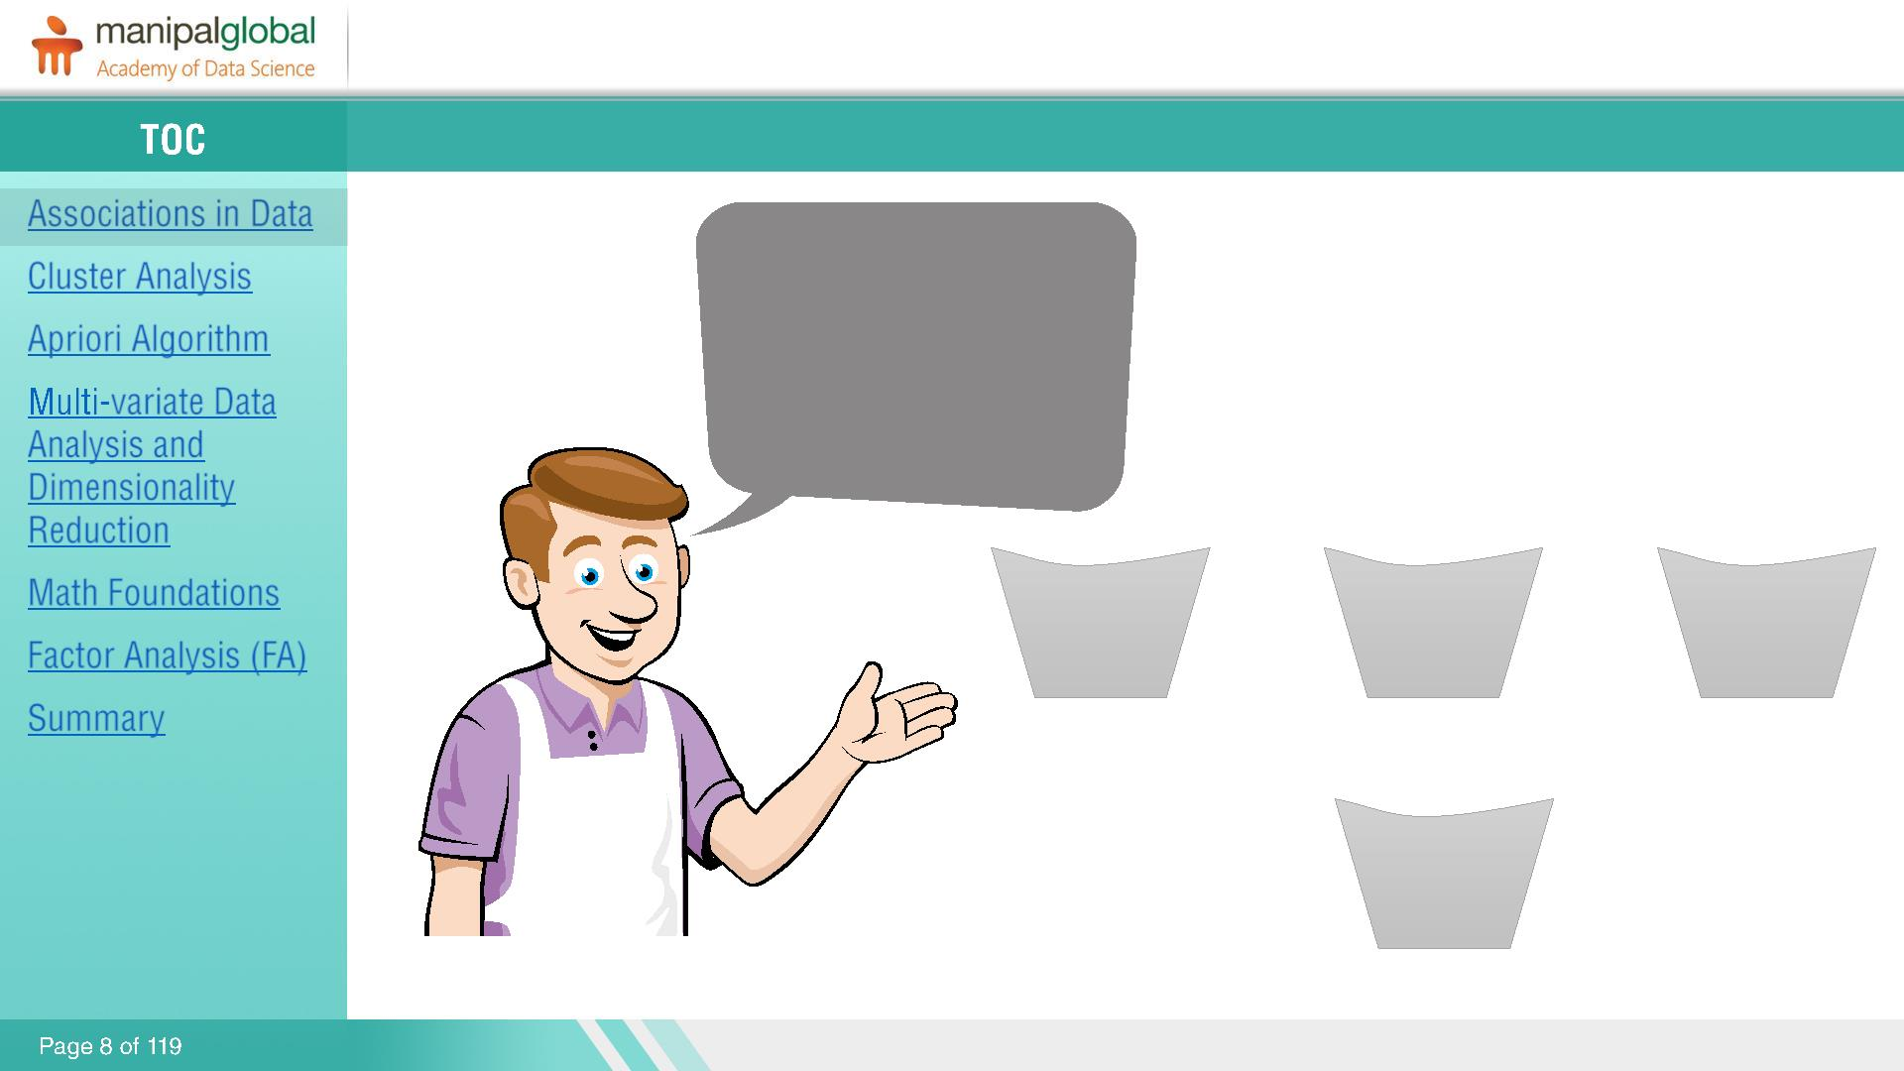
Market Basket Analysis
Which Items are frequently purchased
together by my
customers?
Shopping Baskets
Bread, Milk, Cereal
Bread, Milk, Suger, Eggs
Milk, Bread, Butter
Customer 1
Customer 2
Customer 3
Suger, Eggs
Customer 4

Slide 6
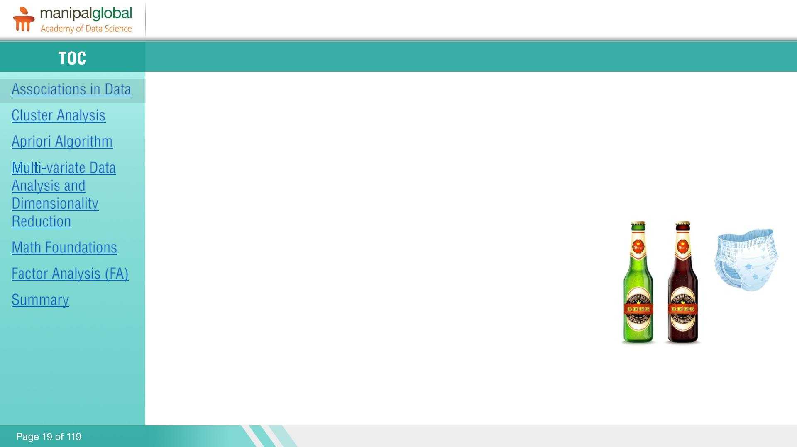
Real Life Examples
Shopping centers use association rules to place the items next to each other so that shoppers buy more items.
Beer-Diapers-Walmart story:
Walmart studied their data and found that on Friday afternoon young American males who buy diapers also tend to buy beer.
Walmart placed beer next to diapers and the beer sales went up.
This is famous, because no one would have predicted such result and that’s the power of data mining.

Slide 7
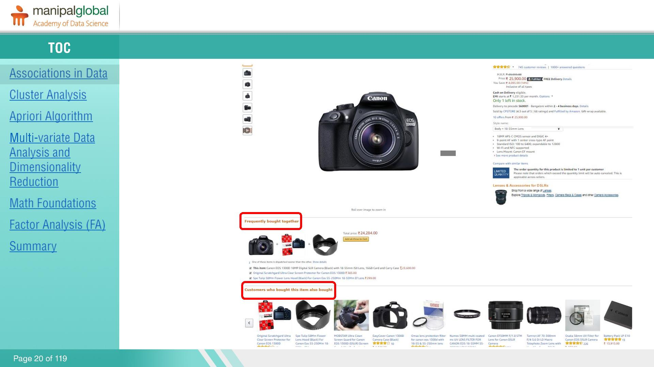
Real Life Examples
Amazon, uses association mining to recommend you the items based on the current item you are

Slide 8
Structure of the Rule - Apriori Algorithm
Metrics used in the case of association analysis:
Confidence:- The conditional Probability that a transaction that contains the items on the LHS of the rule also contains the item on the RHS. The higher the confidence the greater the likelihood that the item on the RHS will be purchased.
Support:- The percentage of transactions that contain all the items in the item set. The higher the support the more frequently the item set occurs.
Lift:- The probability of all the items in a rule occurring together divided by the product of the probabilities of the items on the LHS and RHS occurring as if there was no association between them.

Slide 9
Understanding 3 matrices of MBA

Slide 10
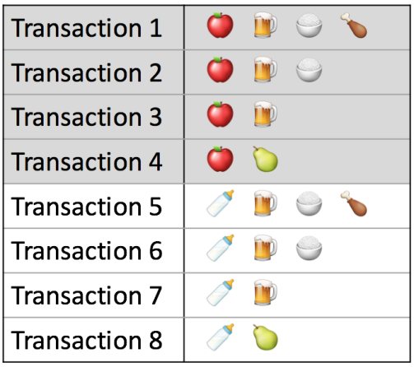

Support
Measure 1: Support. This says how popular an itemset is, as measured by the proportion of transactions in which an itemset appears. The support of {apple} is 4 out of 8, or 50%. Itemsets can also contain multiple items. For instance, the support of {apple, beer, rice} is 2 out of 8, or 25%.
The higher the support the more frequently the itemset occurs. Rules with a high support are preferred since they are likely to be applicable to a large number of future transactions.

Slide 11

Confidence
Measure 2: Confidence. This says how likely item Y is purchased when item X is purchased, expressed as {X -> Y}. This is measured by the proportion of transactions with item X, in which item Y also appears. In Table 1, the confidence of {apple -> beer} is 3 out of 4, or 75%.
The higher the confidence, the greater the likelihood that the item on the right hand side will be purchased

Slide 12
Drawback of confidence measure
One drawback of the confidence measure is that it might misrepresent the importance of an association. This is because it only accounts for how popular apples are, but not beers. If beers are also very popular in general, there will be a higher chance that a transaction containing apples will also contain beers, thus inflating the confidence measure and will make it look like something larger or a very important association. To account for the base popularity of both constituent items, we use a third measure called lift.

Slide 13

Lift
Measure 3: Lift. This says how likely item Y is purchased when item X is purchased, while controlling for how popular item Y is. The lift of {apple -> beer} is 1,which implies no association between items. A lift value greater than 1 means that item Y is likely to be bought if item X is bought, while a value less than 1 means that item Y is unlikely to be bought if item X is bought.
Lift summarises the strength of association between the products on the left and right hand side of the rule; the larger the lift the greater the link between the two products.

Slide 14
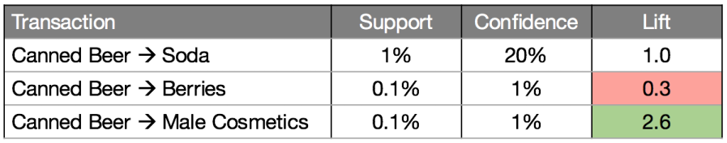
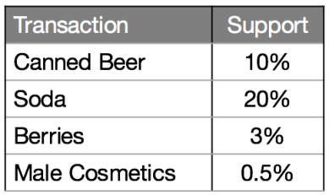
Lets have a look into our data set
The {beer -> soda} rule has the highest confidence at 20%. However, both beer and soda appear frequently across all transactions, so their association could simply be a fluke. This is confirmed by the lift value of {beer -> soda}, which is 1, implying no association between beer and soda.
On the other hand, the {beer -> male cosmetics} rule has a low confidence, due to few purchases of male cosmetics in general. However, whenever someone does buy Beer, he is very likely to buy Male Cosmetics as well, as inferred from a high lift value of 2.6. The converse is true for {beer -> berries}. With a lift value below 1, we may conclude that if someone buys berries, he would likely be averse to beer.

Slide 15
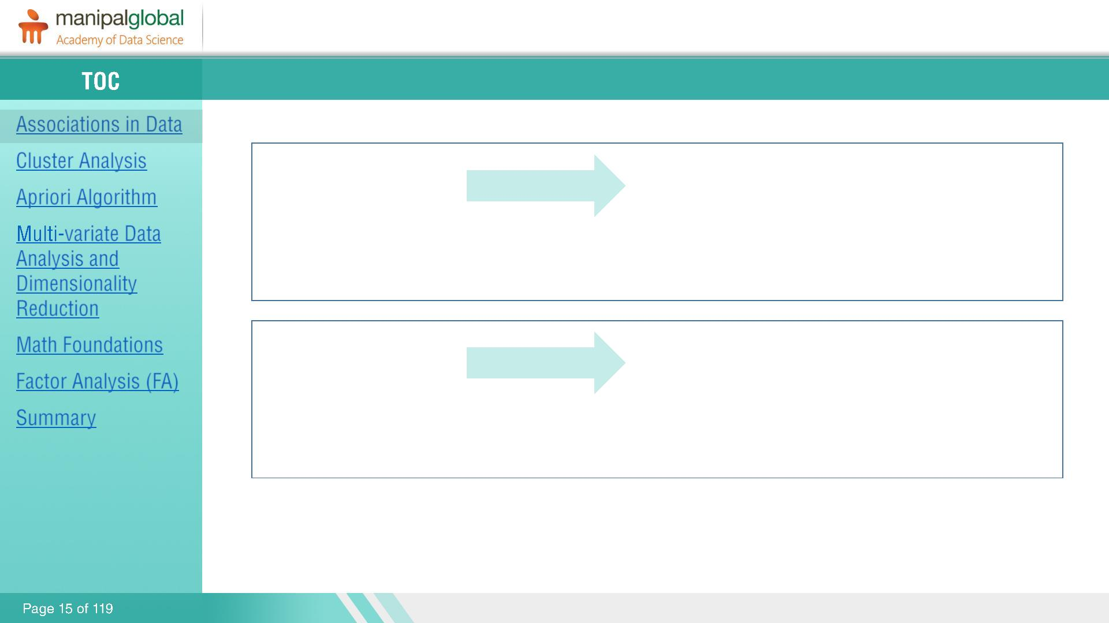
Interpretation of Lift
that item Y is likely to be bought if item X is bought
If lift value > 1
Indicates
while a value less than 1 means that item Y is unlikely to be bought if item X is bought.
If lift value < 1
Indicates

Slide 16
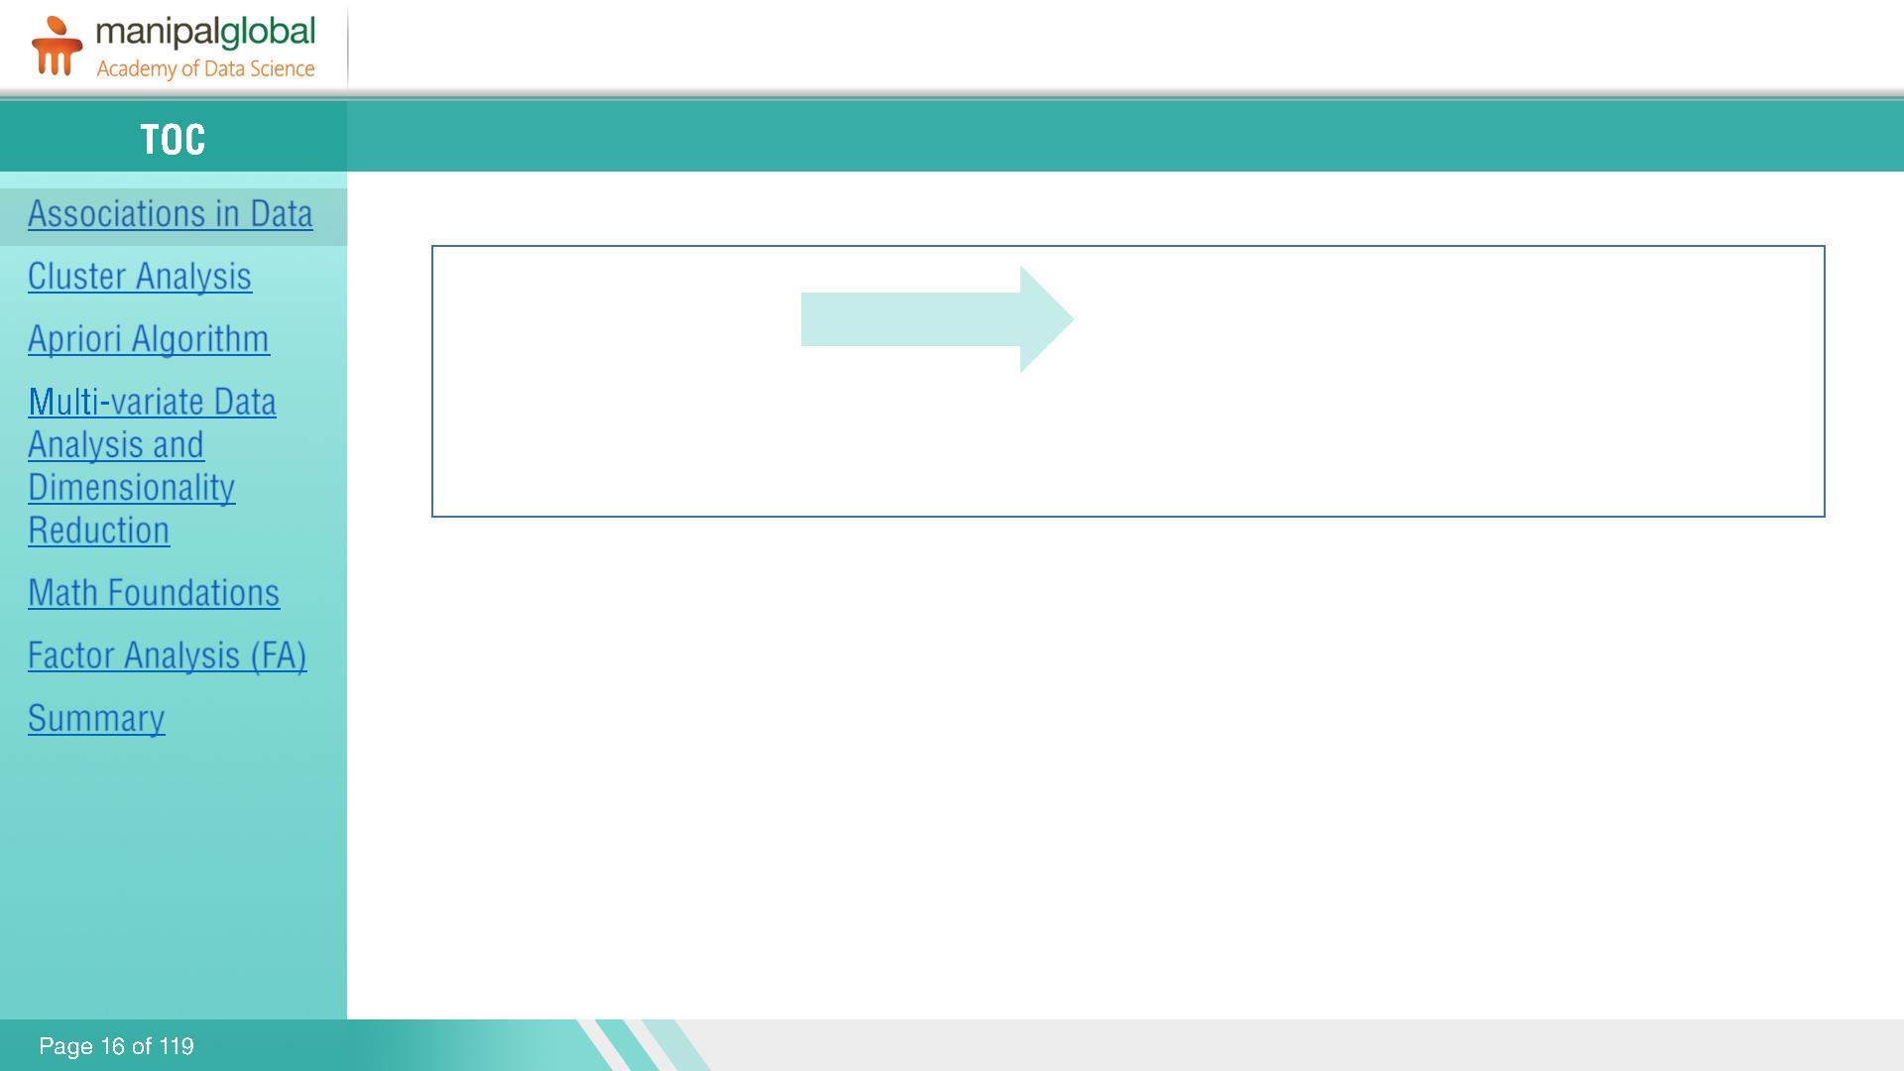
No association between X and Y
If lift value = 1
Indicates
Thus, lift is a value between 0 and infinity.

Slide 17
What is Clustering?
Are variables related to each other??
During data analysis many a times we want to group similar looking or behaving data points together.
Classification and clustering are two fundamental tasks which are there in data mining for long, Classification is used in supervised learning (Where we have a dependent variable) while clustering is used in un-supervised learning where we don’t have any knowledge about dependent variable.
Clustering helps to group similar data points together while these groups are significantly different from each other.

Slide 18
K-Means Clustering
There are multiple ways to cluster the data but K-Means algorithm is the most used algorithm.
It improve the inter group similarity while keeping the groups as far as possible from each other.
K-Means runs on distance calculations, which again uses “Euclidean Distance” for this purpose.
Euclidean Distance =
Above formula captures the distance in 2-Dimensional space but the same is applicable in multi-dimensional space as well.
“K” in K-Means represents the number of clusters in which we want our data to divide into.
The basic restriction for K-Means algorithm is that your data should be continuous in nature. It won’t work if data is categorical in nature.

Slide 19
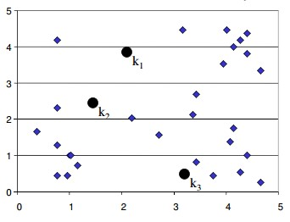
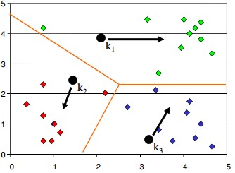
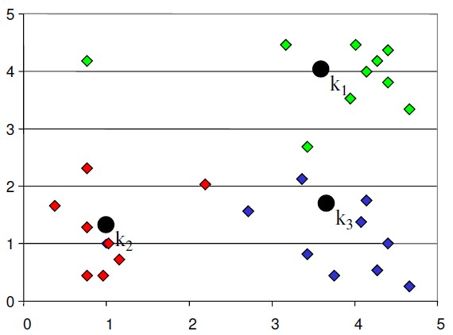
How K-Means work?
STEP 1: Start with number of clusters we want e.g., 3 in this case. K-Means algorithm start the process with random centers in data, and then tries to attach the nearest points to these centers
STEP 2: Algorithm then moves the randomly allocated centers to the means of created groups
STEP 3: In the next step, data points are again reassigned to these newly created centers

